Slide 1
Carbon Nano tubes
Vaibhav Purohit

Slide 2
Introduction
For years science has been a rapidly changing aspect in the human evolution. After its numerous gifts to our species the upcoming new BIG THING is the Carbon Nano Tubes.
The concept is currently in the research and testing phase, but has been implemented in some areas. The nanotubes would replace silicon and be the king of the computer production world.

Slide 3
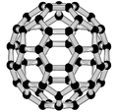
To be Covered
What is CNT?
Why go for CNT?
Types of CNT’s.
How do we get CNT?
Where do we use CNT?
Drawbacks

Slide 4
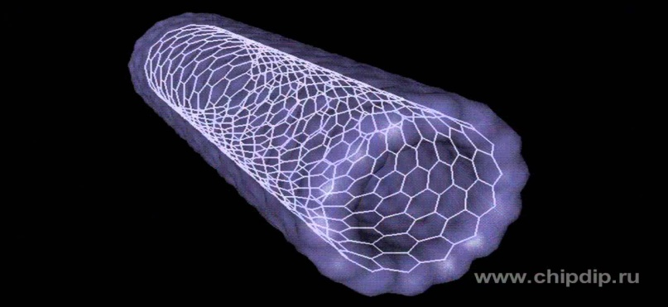
What is CNT
CNT is an abbreviation of Carbon Nanotubes. These are allotropes of carbon having cylindrical nanostructures. Nanotubes are members of the fullerene structural family. These are long, hollow structures with the walls formed by one-atom-thick sheets of carbon, called graphene.
They’re unusual properties make them valuable in the fields of nanotechnology, electronics and even optics.

Slide 5
Specifications
Nanotubes have a length to diameter ratio of up to 132000000 : 1 . Larger compared to other atomic substances but still microscopic and much smaller compared to the silicon MOSFETs used currently.
Carbon nanotubes have a tensile strength of around sixty-three gigapascals. That is equivalent to 6.4 tonnes.

Slide 6
Why CNTs?
Carbon Nanotubes if properly implemented are a complete transformation package for the new technology.
Shifting to nanotubes would be advantageous due to its various properties, abundance of carbon, puniness in its size and above all the fact that it will reduce the dependency of any other kind of material or device.

Slide 7
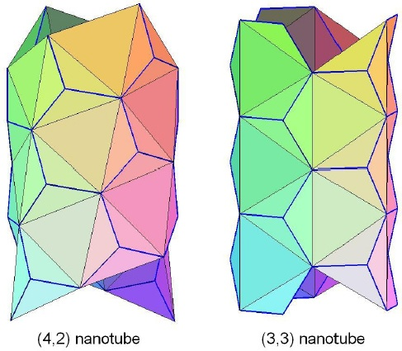
Chirality Factor
The key factor of the nanotubes’ independence to transform to anything is the Chiral Angle of HydroCarbons.
The specific and discrete chiral angles determine the nanotubes properties. For example the angle and radius decides whether the shell is a Metal(Conductor) or a Semiconductor.

Slide 8
Tiny but Strong
The nanotubes if talked about size then 10000 shell strands together would be comparable to the human hair. That is even smaller than the optical fiber threads we use in the present communication technology.
Carbon nanotubes are the strongest and stiffest materials yet discovered in terms of tensile strength and elastic modulus. To appreciate its strength properly let us compare it to another carbon allotrope we all call Diamond.

Slide 9
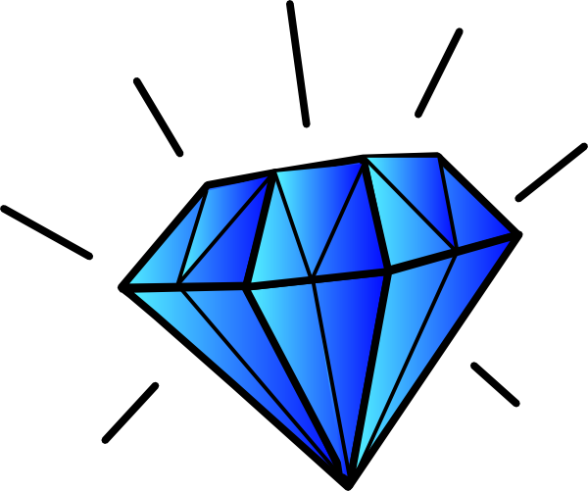
How strong is it?
Diamonds as we know are the strongest substances on earth(Until Now).
Diamonds are composed of SP3 configured covalent carbon bonds which are quite strong. An SP2 covalent bond is even stronger than the SP3 bond due to the presence of a double bond.
The nanotubes that we call so strong are composed of carbon covalent bonds having 80% of the bonds in the SP2 configuration.
This leaves no doubt that they are quite much the strongest substances on earth.

Slide 10
Other Properties
Hardness – More than ever seen in anything else.
Wettability-The extreme water repellent surface can also be switched to superhydrophilic.
Kinetic- They have been utilized to create the world's smallest rotational motor with almost no friction.
Electrical-Can be used as conductors as well as semiconductors.
Thermal-High thermal conductivity exhibiting Ballistic Conduction.
Optical-Photoluminescence as well as Spectroscopy.

Slide 11
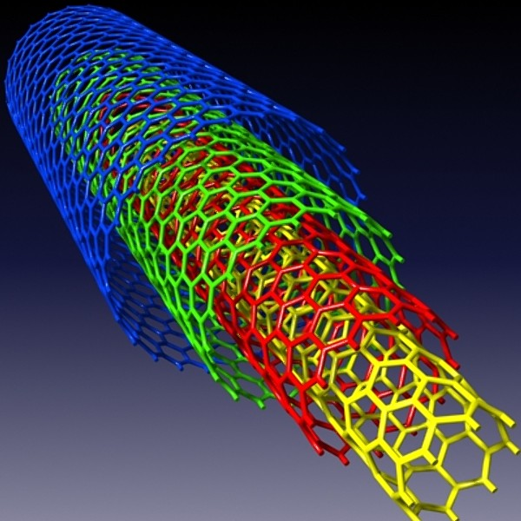
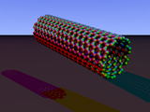
Variety of CNTs
Single walled – Single cylinder
Multi walled – Multiple rolled layers
Nanotorus – Doughnut shaped(Enhanced magnetic properties)
Nanobud – Hybrid fullerenes
Graphenated (g-CNTs)
Nitrogen doped CNTs

Slide 12
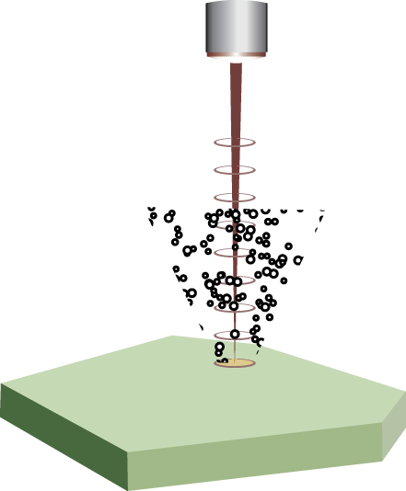
How CNTs
Various synthesis techniques have been developed to produce nanotubes in sizable quantities. These are –
Arc Discharge
Laser Ablation
Plasma Torch
Chemical Vapor Deposition

Slide 13
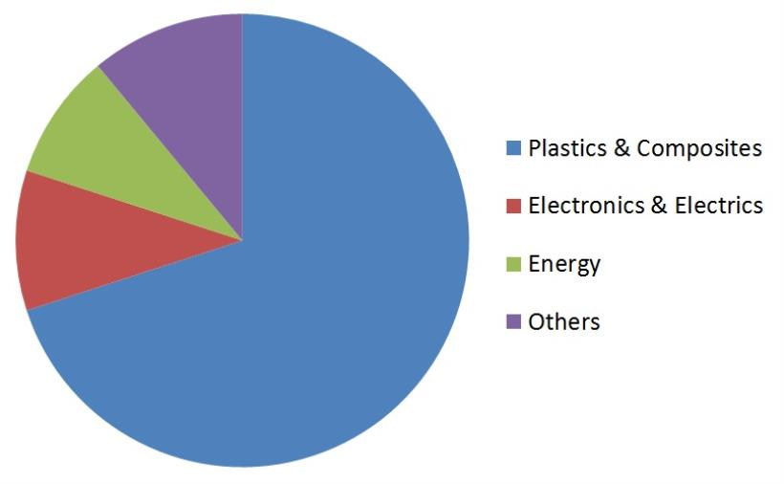
Where CNTs?
A discovery of such a useful substance of course does have many applications in various areas of today’s science and technology.
The different enhanced properties of the nanotubes make it valuable for the technical evolution of the human race.

Slide 14
Potential Applications
Bio-Medical
Electrical circuits
Material structures
Paper batteries
Solar cells
Hydrogen storage
Radar absorption
Supercapacitors
Textile
Acoustics
Water treatment

Slide 15
Drawbacks
As has been history every new concept has its own pro’s and cons. The nanotubes too exhibit some defects and drawbacks.
Atomic vacancies may lead to lack in properties.
The toxicity is yet to be analyzed but if raw materials reach the organs, they can induce harmful effects such as inflammatory and fibrotic reactions.

Slide 16
Conclusion
Completing this presentation on CNTs we can conclude that these would prove to be a big game changer in the current tech industry.
We need to remember that this is just a minor segment of the upcoming technology Nanotechnology which will the rule the world in the near future until something new is invented to overthrow it.

